Slide 1

Smart Greenhouse Monitoring & Automation System

Slide 2
An End-to-End IoT Prototype for Real-Time Environmental Monitoring and Automated Irrigation
Developed by: Mahdi Javahery
Technology Stack
Embedded Systems
IoT
Backend Development
Data Monitoring
Automation

Slide 3
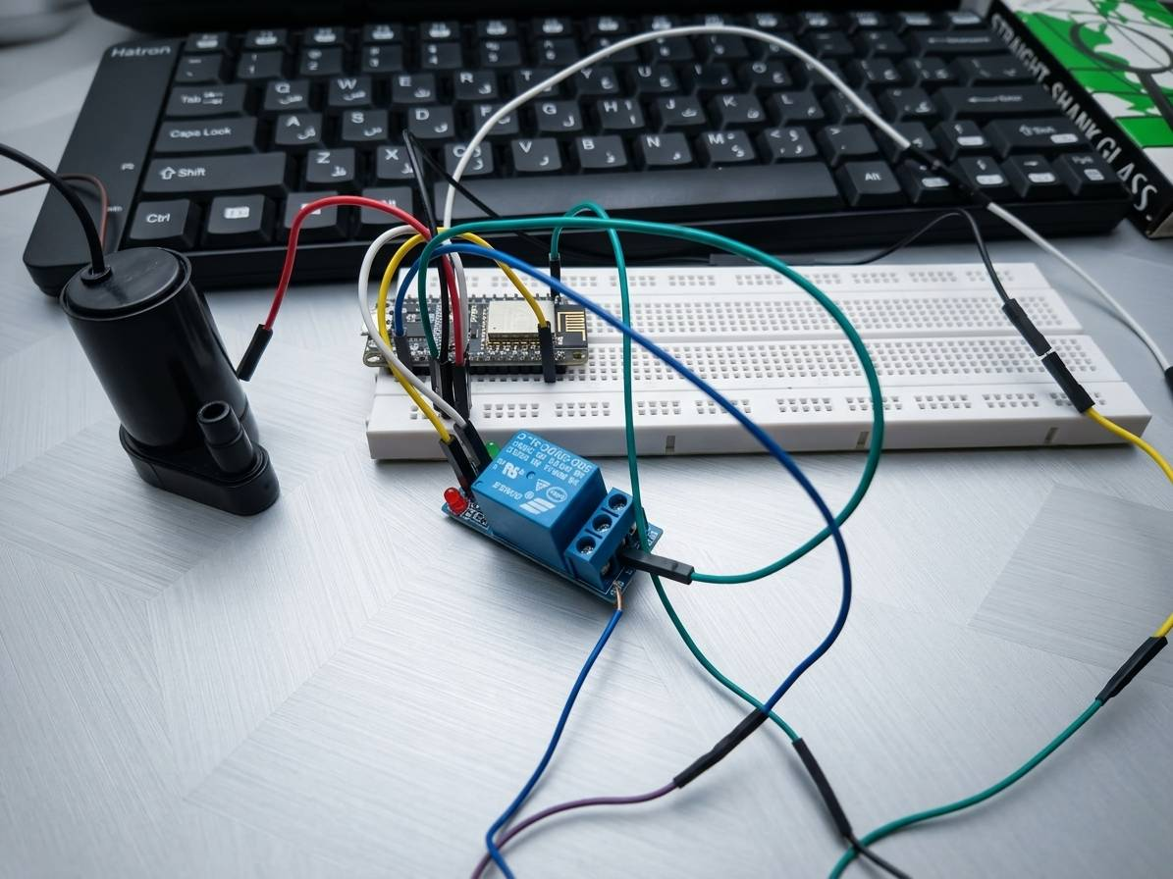
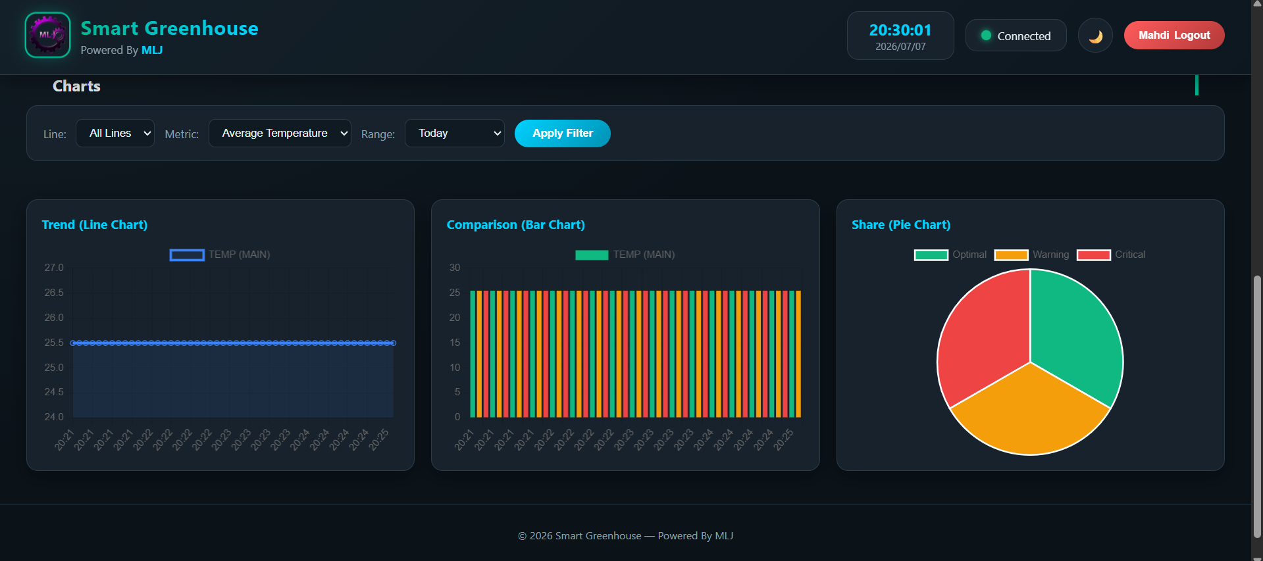
System Components in Action

Slide 4
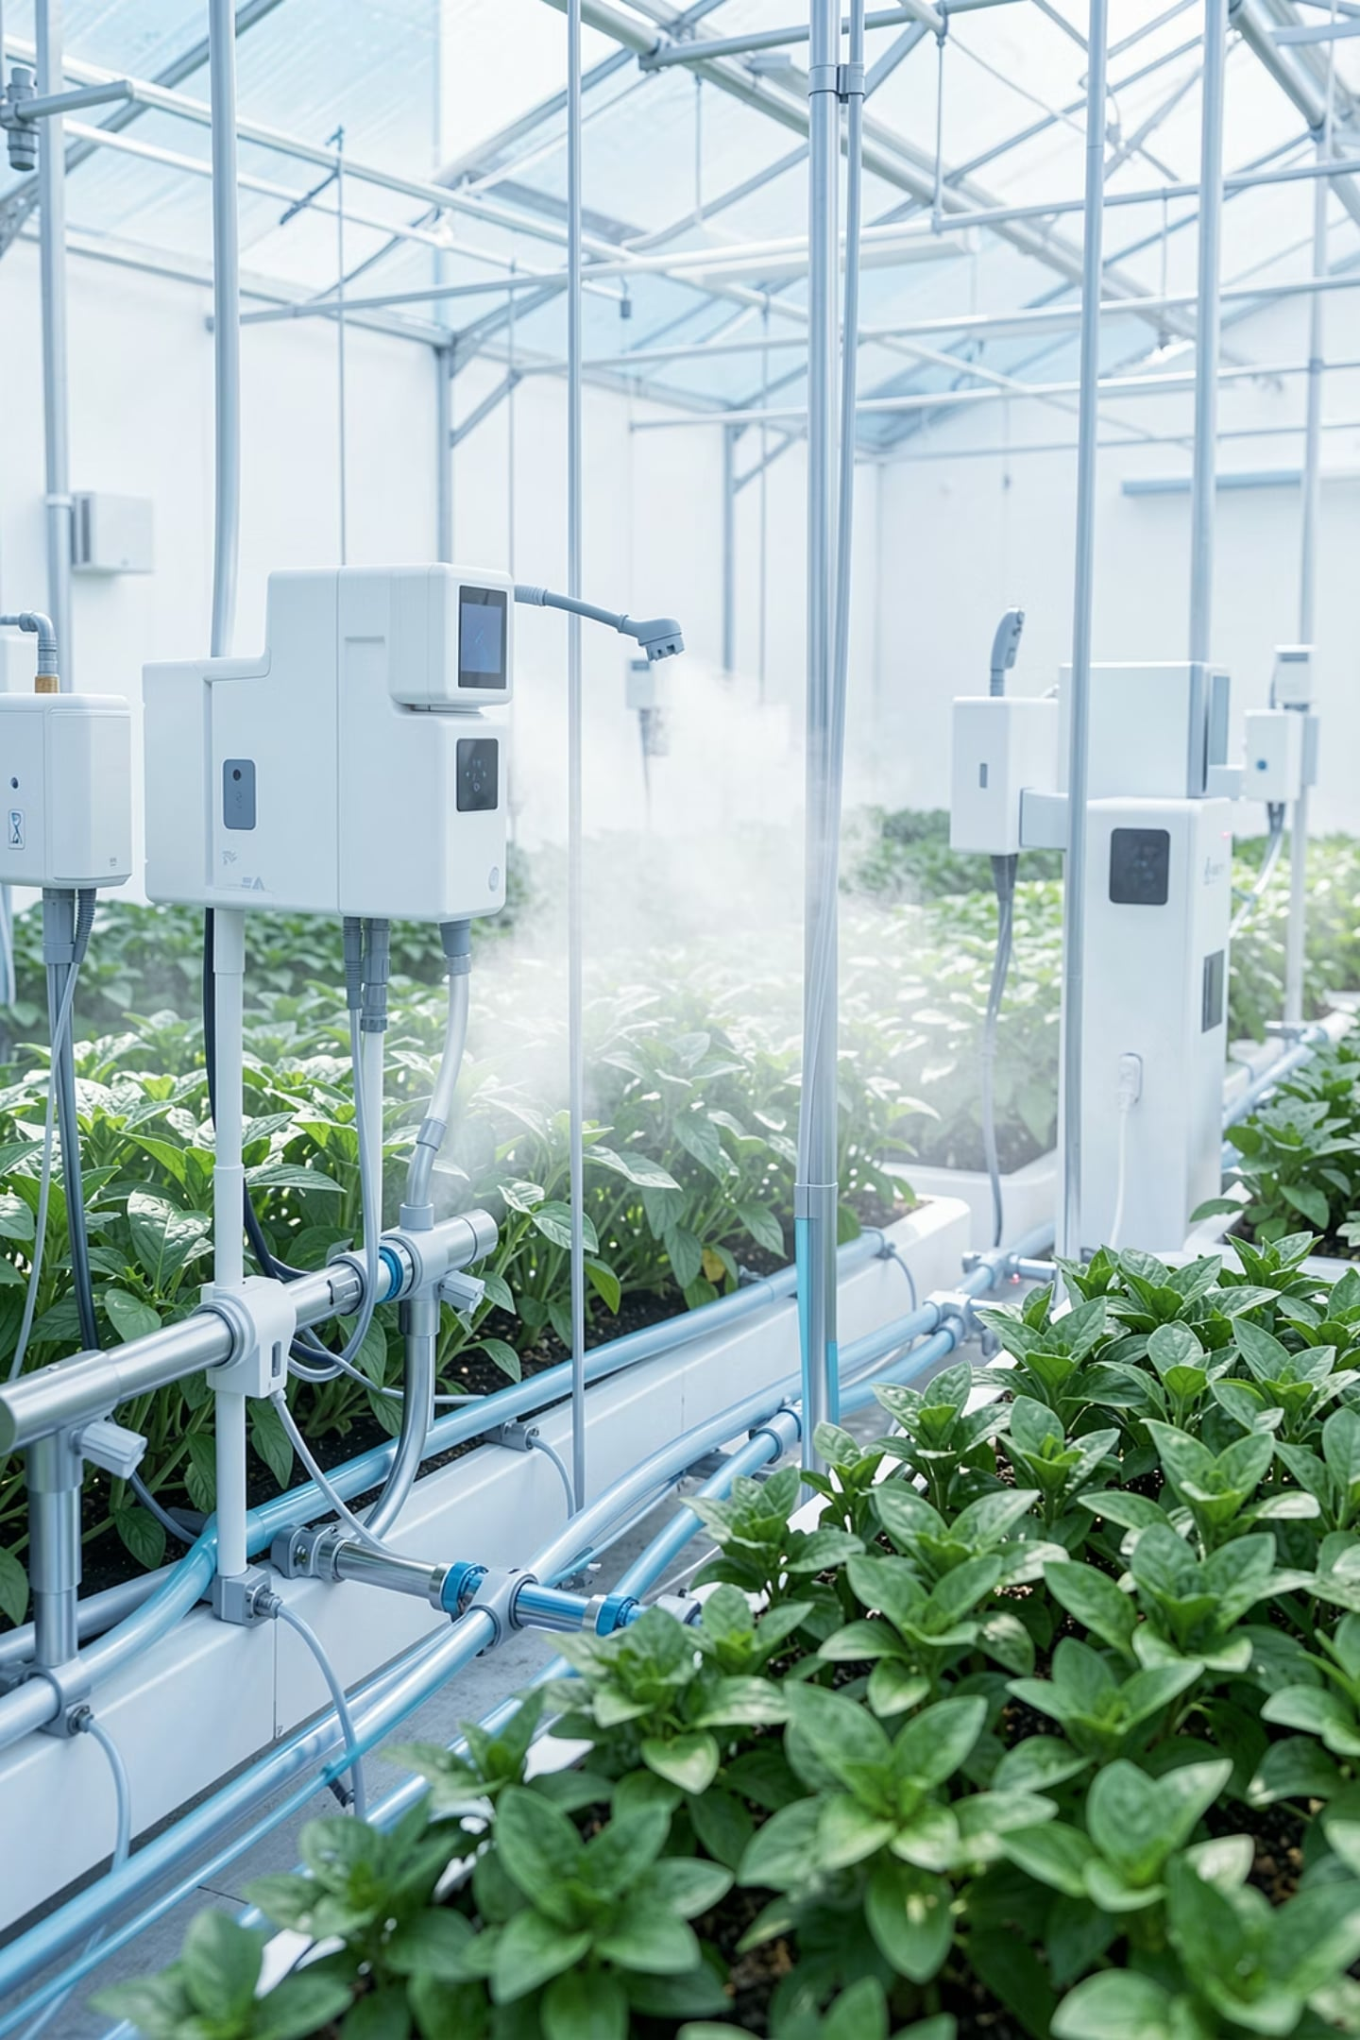
Project Introduction
This project focuses on designing and developing an IoT-based greenhouse monitoring and automation prototype that integrates embedded hardware, backend services, database management, and a web monitoring dashboard.
Key Capabilities
Real-time Environmental Monitoring
Automated Irrigation Control
Historical Data Storage
Remote System Observation

Slide 5
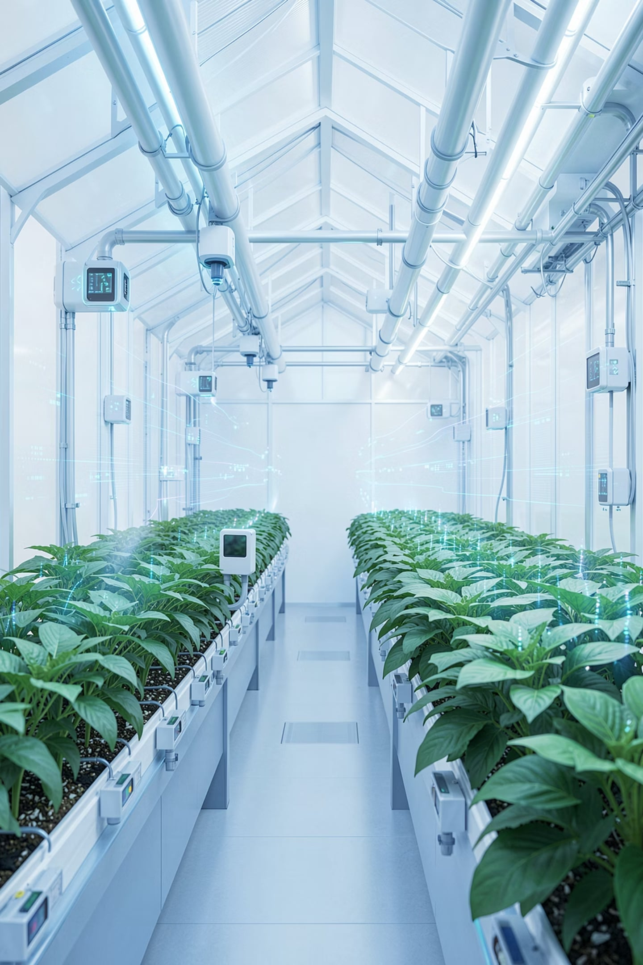
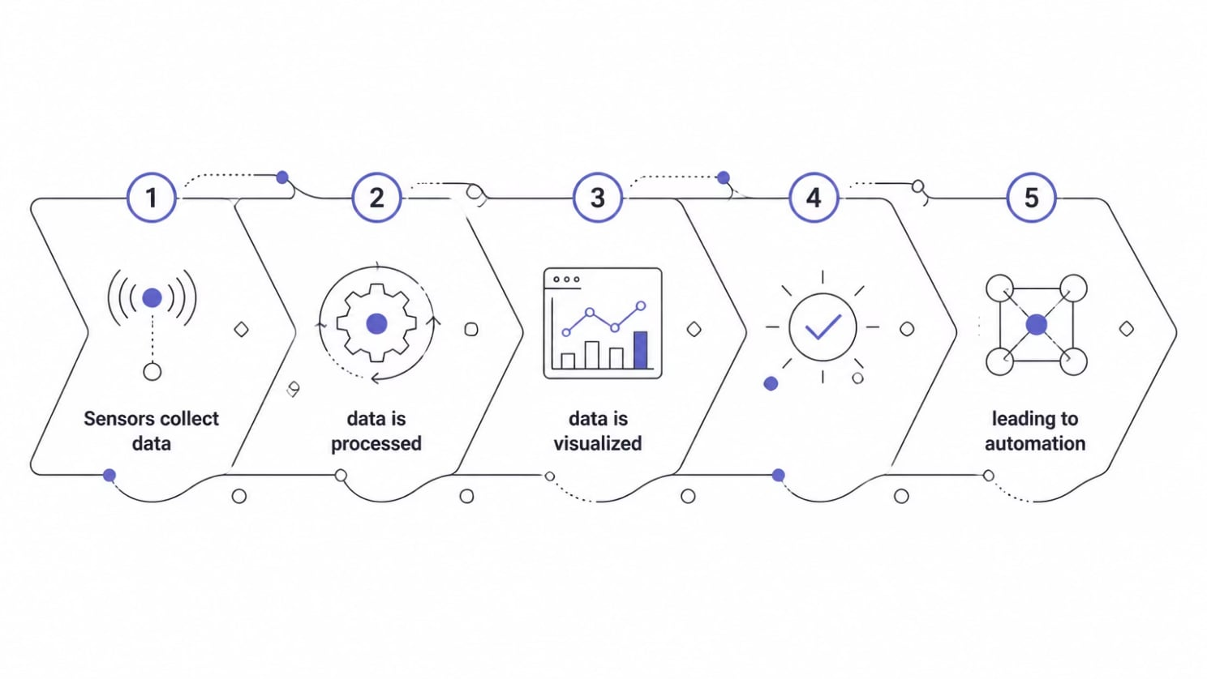
Why Smart Greenhouse?
Traditional greenhouse management often leads to inefficiencies and suboptimal plant growth due to several inherent challenges:
Manual Environmental Monitoring
Reliance on manual checks makes it difficult to maintain consistent optimal conditions, leading to fluctuations in temperature, humidity, and soil moisture.
Inefficient Resource Usage
Without precise control, water and nutrients are often over-applied, leading to waste and increased operational costs.
Lack of Continuous Data
Intermittent data collection prevents a comprehensive understanding of long-term trends and immediate critical changes.
Limited Decision-Making
Absence of historical analysis restricts the ability to learn from past cycles and optimize future growing strategies.
The Solution
Our IoT system addresses these challenges by implementing a seamless, automated workflow:

Slide 6
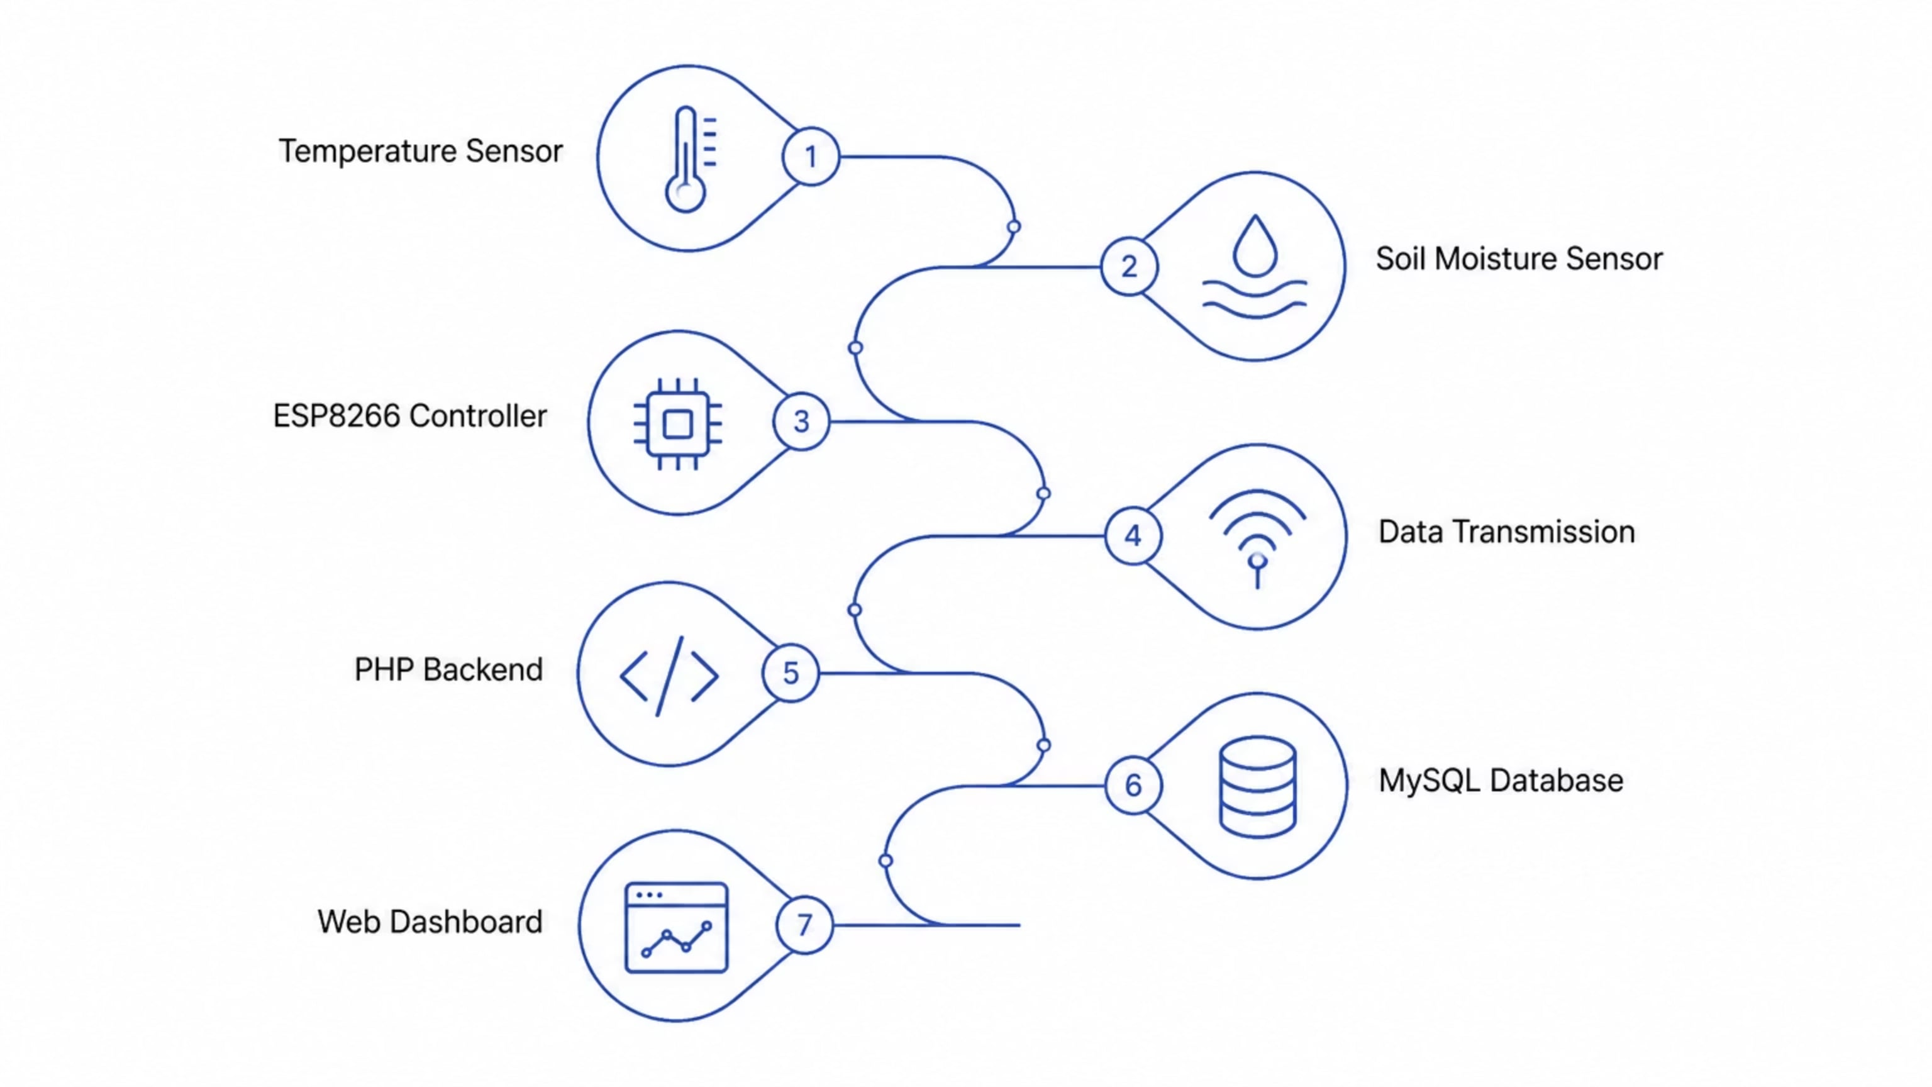
Overall System Architecture
Our smart greenhouse system is built on a robust, layered architecture, ensuring seamless data flow from environmental sensing to real-time web monitoring and automated control.
This design separates hardware, data processing, and visualization components, allowing for modular development and easier maintenance.

Slide 7
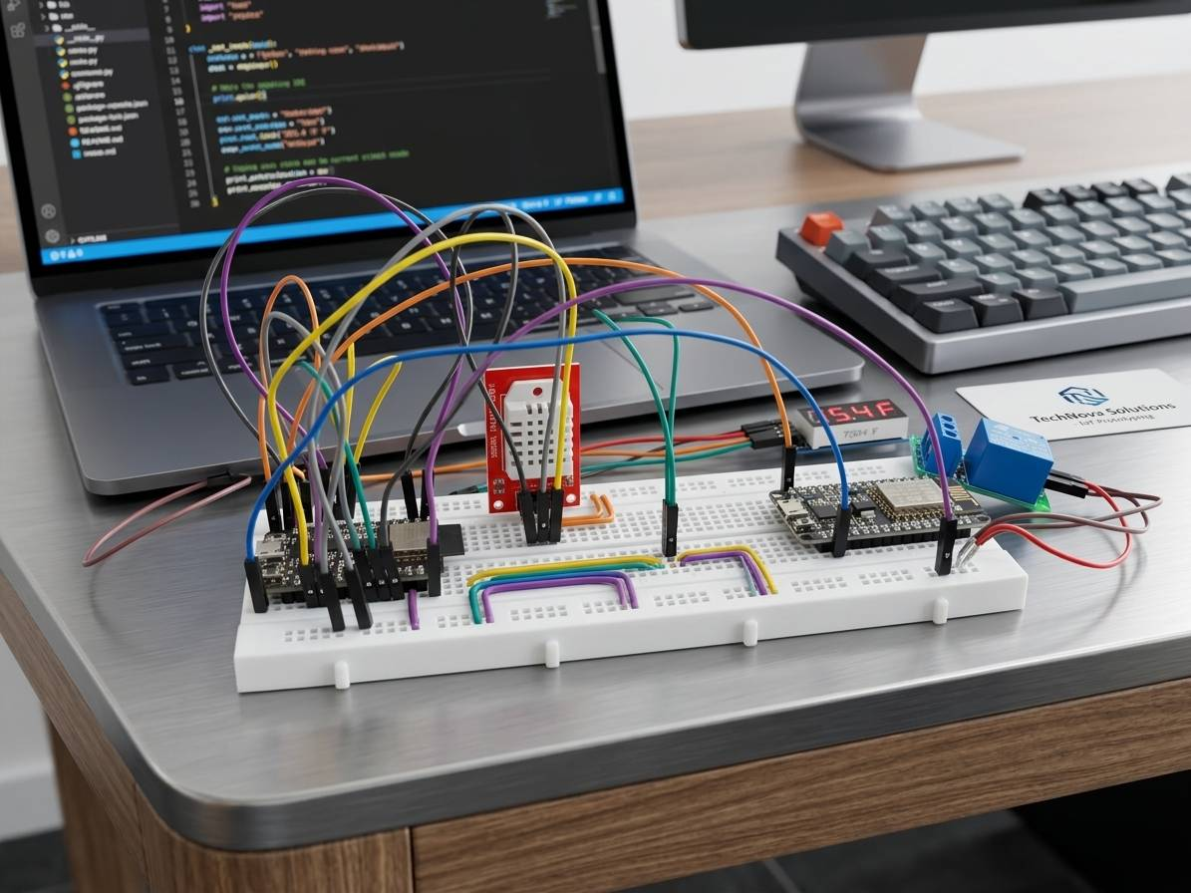
Embedded Hardware Implementation
The foundational hardware layer was meticulously developed as a functional IoT prototype, initially leveraging a breadboard-based architecture for flexibility and rapid iteration.
ESP8266 Microcontroller
The brain of the system, handling data processing and communication.
Soil Moisture Sensor
Continuously monitors the water content in the soil.
Temperature Sensor
Records ambient greenhouse temperature for optimal plant growth.
Relay Module
Controls the power supply to the water pump based on sensor data.
Water Pump
Delivers water to plants for automated irrigation.
This breadboard setup facilitated thorough prototype validation, ensuring each component functioned as intended before transitioning to a more compact Printed Circuit Board (PCB) design.

Slide 8
Edge Controller Operation
The ESP8266 serves as the core edge controller, performing critical real-time operations to maintain optimal greenhouse conditions. Its responsibilities span data acquisition, local processing, and dynamic system control.
01
02
Sensor Reading
Data Processing
The ESP8266 continuously polls connected sensors to gather raw environmental data, including soil moisture, temperature, and humidity levels.
Raw sensor data is locally processed and filtered to ensure accuracy and reduce noise before further transmission or decision-making.
03
04
Send Data
Pump Decision
Processed measurements are securely transmitted to the central server and database, enabling real-time monitoring and historical logging.
Based on pre-defined thresholds and current soil moisture data, the ESP8266 autonomously determines if irrigation is required.
05
Relay Control
If irrigation is needed, the controller activates the relay module to switch on the water pump, ensuring precise and timely watering.

Slide 9
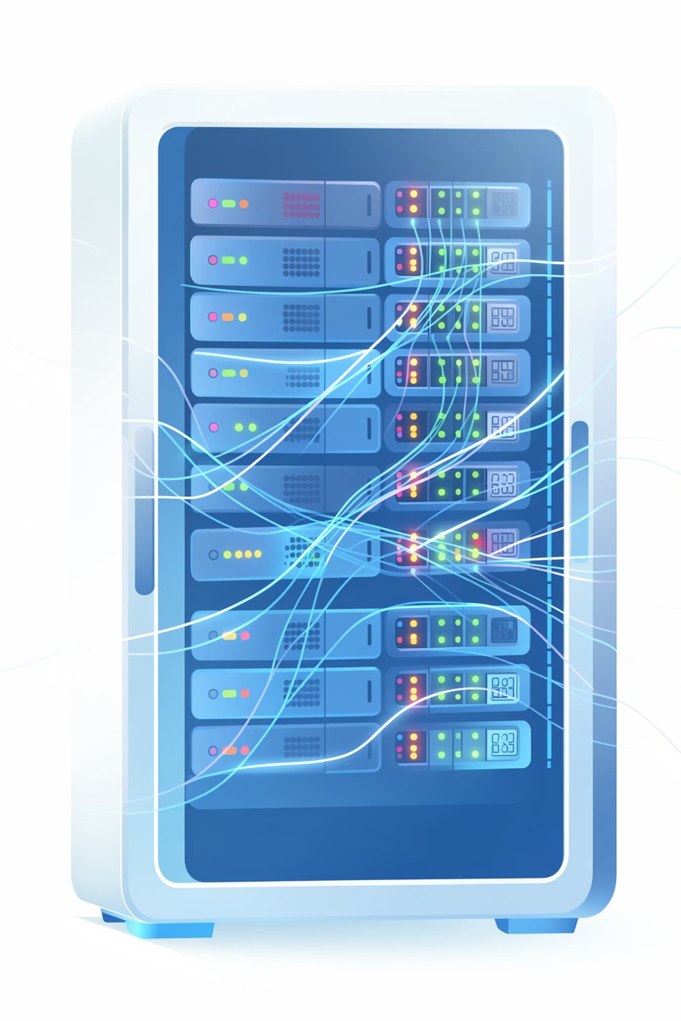
Server-Side Data Management
The backend was developed using PHP to provide robust communication and data management between embedded devices and the monitoring platform, serving as the central hub for all IoT operations.
Key Responsibilities
Receiving Sensor Data
Processing Measurements
Managing Database Operations
Securely ingests raw environmental data transmitted from the ESP8266 controller.
Performs initial validation, aggregation, and formatting of incoming sensor data.
Handles storing historical and real-time data efficiently in the MySQL database.
Providing Data for Visualization
Serves processed data to the web dashboard for real-time monitoring and analysis.
Core Technologies
PHP
MySQL
Chosen for its reliability and wide adoption in web development, enabling efficient server-side scripting.
A powerful relational database management system for storing and retrieving large volumes of sensor data.

Slide 10
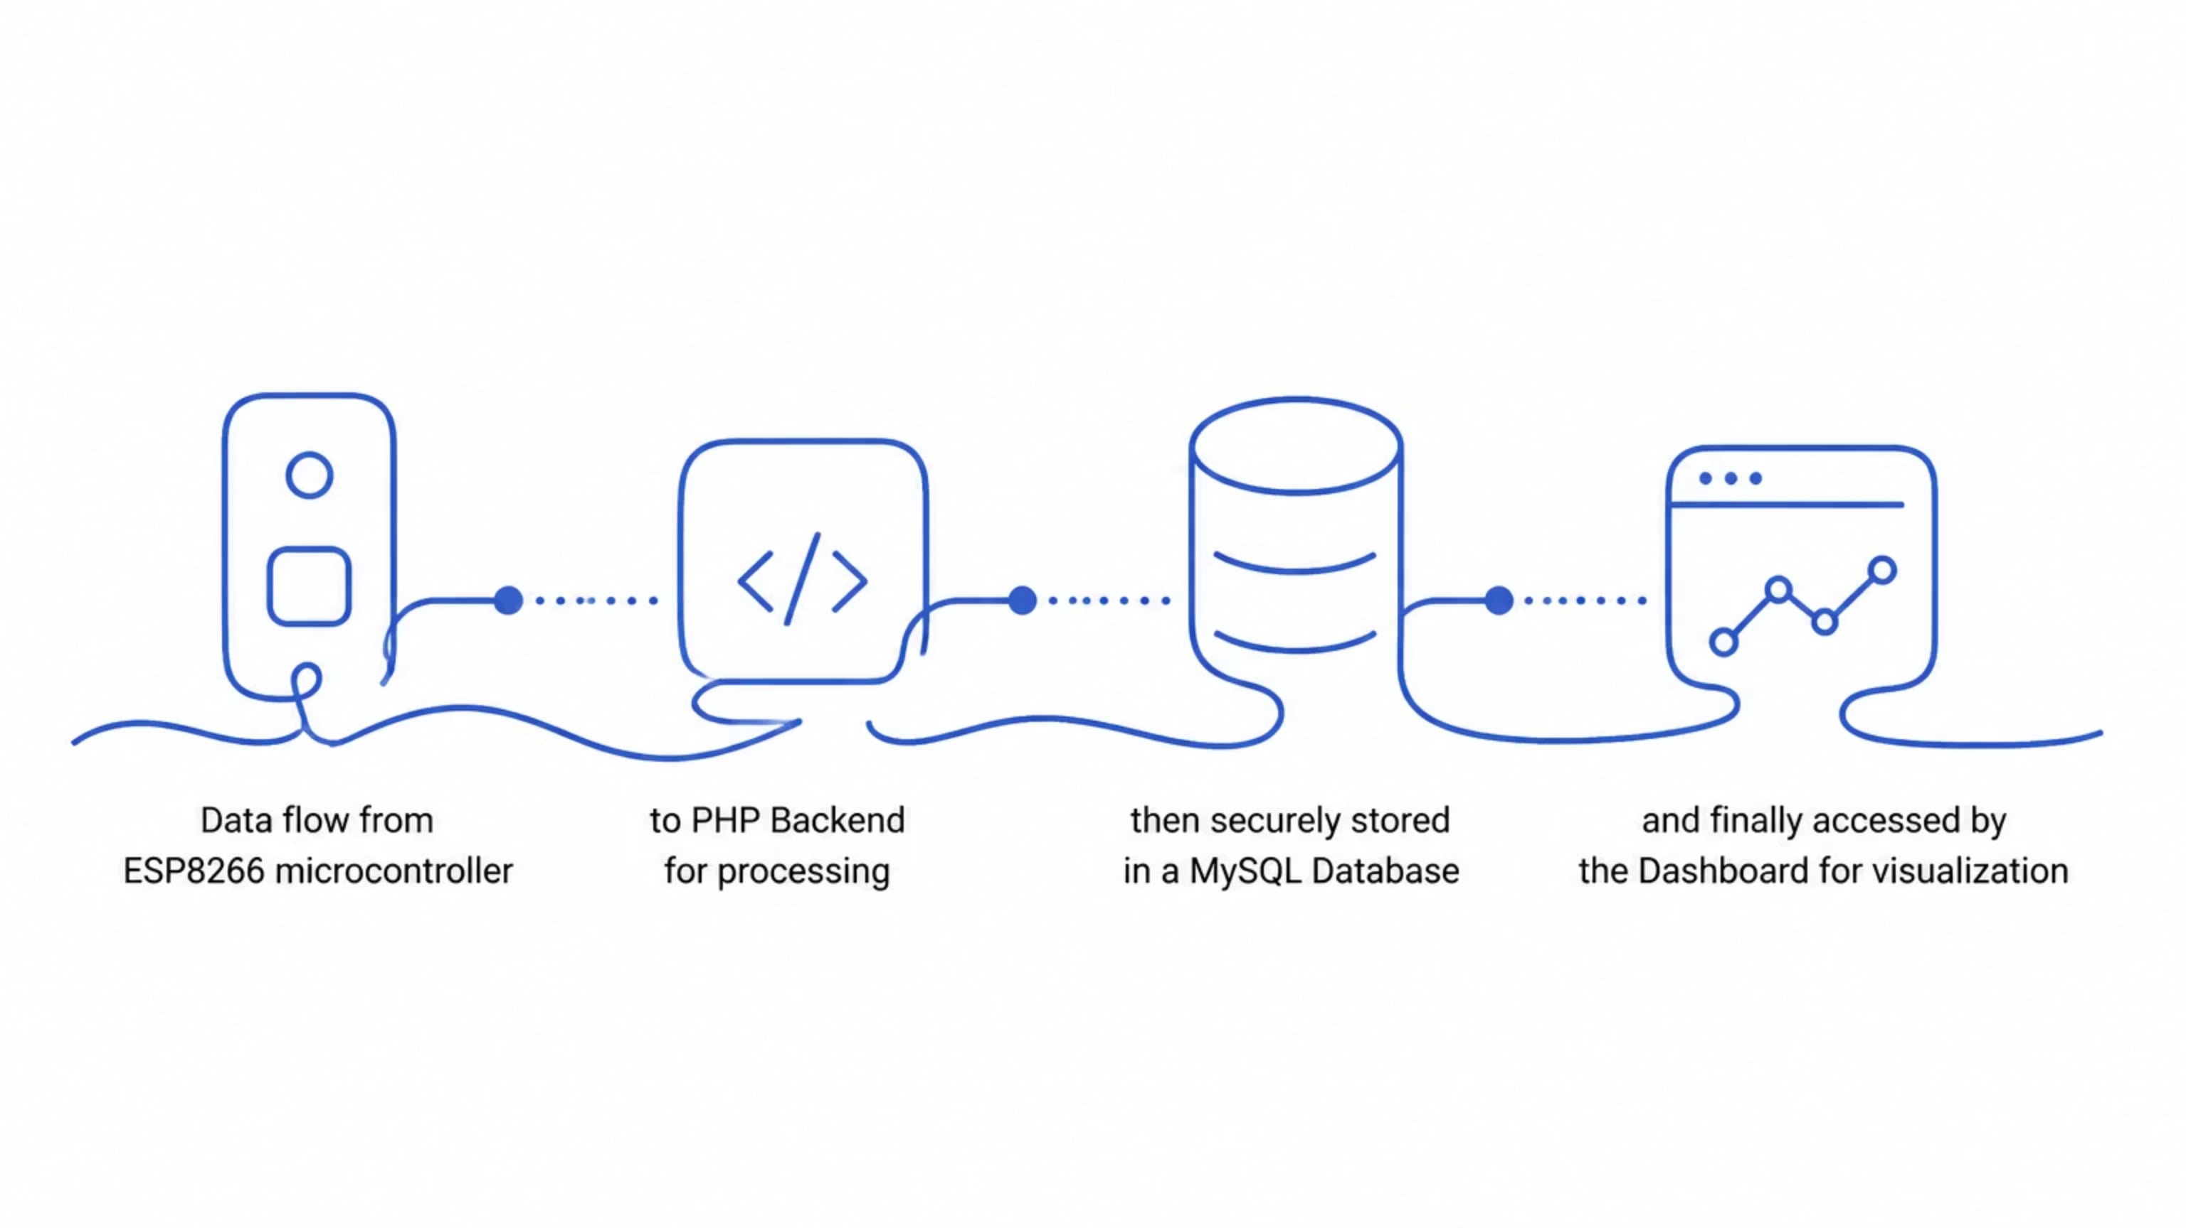
Data Storage Architecture
Our robust data storage architecture ensures reliable collection, processing, and availability of all greenhouse-related data, supporting both real-time insights and long-term analysis.
The MySQL database is specifically designed to manage the high volume of incoming sensor data and operational logs, ensuring data integrity and efficient retrieval. It comprehensively stores:
Sensor Measurements: Detailed readings from temperature, humidity, and soil moisture sensors.
Timestamps: Precise time records for every data point, crucial for chronological analysis.
Device Status: Operational logs and status updates from the ESP8266 controller.
Historical Environmental Data: A complete archive for trend analysis, predictive modeling, and identifying long-term growth patterns.

Slide 11
Real-Time Monitoring Interface
A custom web dashboard was developed to visualize greenhouse conditions, providing users with instant insights and control over their environment.
Key Features:
Real-time Sensor Monitoring
Temperature Visualization
Soil Moisture Tracking
Monitor soil humidity levels over time to optimize irrigation schedules and prevent over/under-watering.
Instantly view live readings from all environmental sensors, including air temperature, humidity, and soil moisture.
Observe current and historical temperature trends through interactive graphs and custom alerts.
Pump Status Monitoring
Historical Data Analysis
Check the operational status of the automated irrigation pump and manually trigger watering cycles if needed.
Access comprehensive archives of past sensor data to identify patterns, evaluate plant health, and refine growing strategies.

Slide 12
Development & Deployment Workflow
The project was managed using modern development practices, ensuring a streamlined and collaborative process from coding to deployment.
Tools Utilized
Key Benefits
Git: For distributed version control and collaborative development.
GitHub: Our central repository for code hosting and team collaboration.
Docker: To create reproducible environments across development and production.
Easier deployment: Consistent environments minimize setup issues.
Reproducible environment: Ensures consistent behavior across different systems.
Better project maintenance: Version control and containerization simplify updates and debugging.

Slide 13

Challenges & Solutions
Developing an end-to-end IoT system presented unique challenges, each met with thoughtful design and implementation strategies to ensure project success.
Challenge
Solution
Hardware integration
Modular sensor and actuator design
Real-time communication
Designed continuous data flow
Hardware-software connection
Integrated ESP8266 with backend
Data visualization
Developed monitoring dashboard
These solutions were instrumental in transforming complex technical hurdles into reliable, functional components of the smart greenhouse system.

Slide 14
Key Achievements & Successes
The prototype system successfully delivered on its core objectives, demonstrating a robust and functional IoT solution for smart greenhouse management.
End-to-End IoT Workflow
Fully implemented a seamless flow from sensor data acquisition to server processing and automated control, ensuring reliable system operation.
Real-Time Monitoring
Enabled continuous, live tracking of critical environmental parameters within the greenhouse, providing up-to-the-minute insights.
Automated Irrigation
Successfully integrated an intelligent irrigation system that automatically waters plants based on predefined moisture thresholds.
Web-Based Visualization
Developed an intuitive web dashboard for clear data visualization and remote control, enhancing user interaction and management.
Integrated Hardware & Software
Achieved robust integration between custom hardware (ESP8266, sensors) and backend software, demonstrating a cohesive system.

Slide 15
Next Steps: Future Improvements
To further enhance the Smart Greenhouse system, we've identified key areas for future development across hardware, software, and intelligence.
Hardware Evolution
Software Expansion
Intelligence & Automation
Custom PCB design for miniaturization and cost reduction.
Dedicated IoT controller board for enhanced processing power and reliability.
REST API development to support broader integrations.
MQTT communication for real-time, lightweight messaging.
Mobile application for remote monitoring and control on the go.
AI-based irrigation prediction using historical data and weather forecasts.
Advanced cloud-based monitoring with anomaly detection and predictive analytics.

Slide 16




Final Overview
This project successfully demonstrates the complete development cycle of an end-to-end IoT solution for smart agriculture.
Hardware Integration
Backend Services
Physical sensors and embedded controllers form the foundation of data acquisition.
Robust server-side processing and secure data management.
Scalable Foundation
User Visualization
A prototype ready for future expansion into advanced smart agriculture systems.
Intuitive interfaces for real-time monitoring and control.

